Slide 1





Shreshth Saini
Marketing Proposal
Helping brands scale with data-driven strategy, creativity & measurable ROI
4.7(361)
Start Now
View Portfolio
Happy Client Score

Slide 2


Shreshth Saini
My Marketing Approach
01. Audit & Research
02. Strategy & Messaging
03. Execution
04. Measurement
Data-driven marketing
05. Optimization
I apply a structured
Audit → Create → Execute →
Optimize framework to deliver
measurable growth. My approach
balances creativity with analytics,
ensuring campaigns not only launch
but also scale effectively.
06. Tracking

Slide 3



Shreshth Saini
Passion, Innovation, and Success
Long-term goals and commitment to excellence.
This plan outlines key initiatives in market research, digital promotion, customer engagement, and brand positioning.
Key milestones and recognitions.
Read More

Slide 4


Shreshth Saini
Key Market Insights: Understanding the Landscape
Identification Of Growth Areas And Market Gaps.
With a clear roadmap, we aim to strengthen our competitive advantage, increase awareness, and drive long-term business success.
Trends Impacting
It includes strategies in digital marketing, social media, and targeted campaigns to ensure measurable results.
Our goal is to create sustainable growth by staying relevant
See Articles

Slide 5
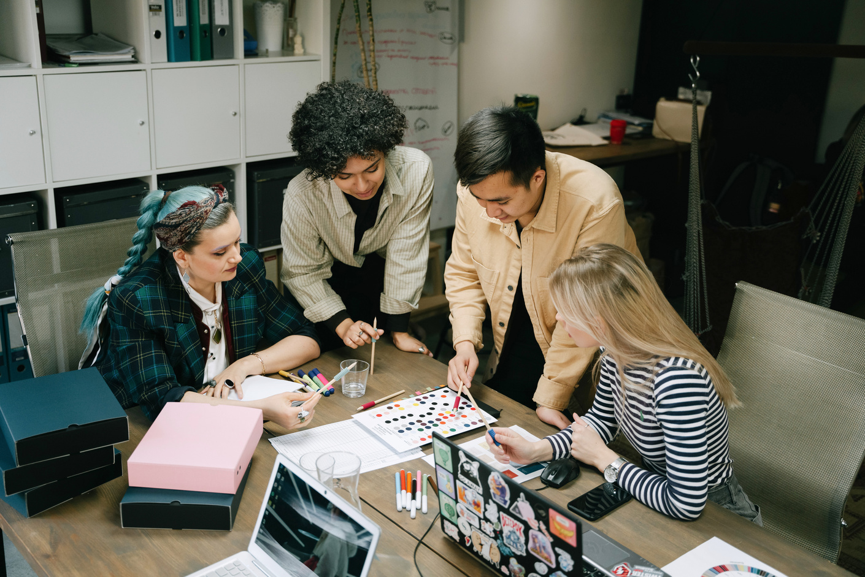
Shreshth Saini
Tailored Solutions: Our Core Services
01. Brand Strategy Development
guide to strengthen our brand presence.
02. SEO & SEM Optimization
reach new audiences, and improve customer loyalty.
Essential Service Offering.
03. Public Relation & Media Outreach
By combining data-driven insights with creative storytelling.

Slide 6
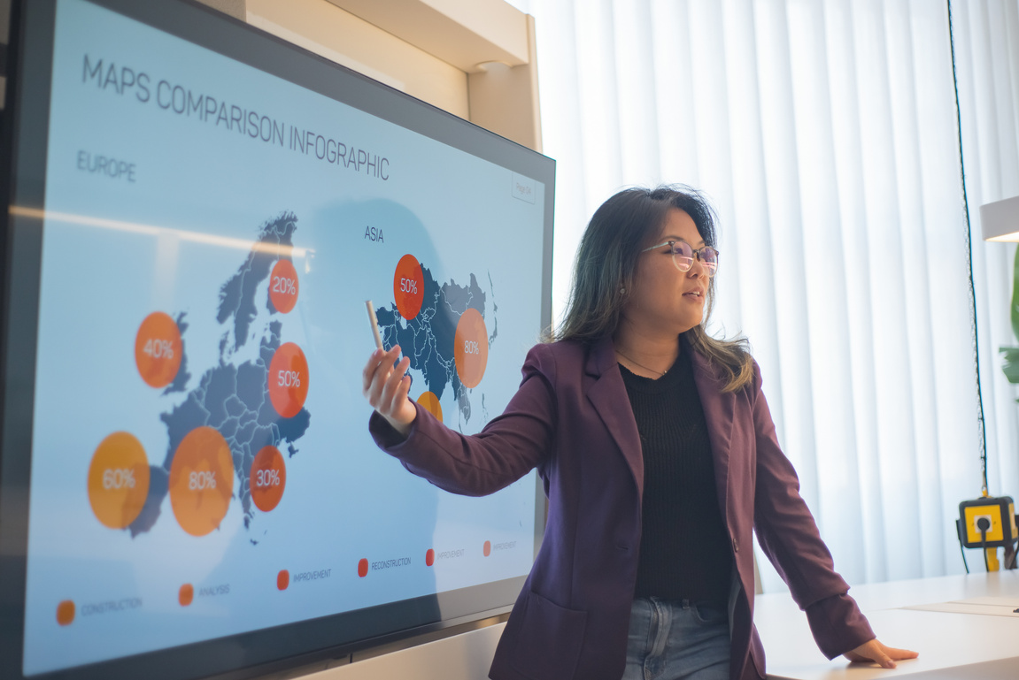
Shreshth Saini
Key Performance Indicators
The analyst uses this information to inform marketing strategies and decision-making.
82%
My marketing plan is more than just a strategy—it is a vision to connect people with brand’s through meaningful experiences.
Percentage
Rates
Metric
Roi
Sales
Grow
11M +
450K
#01
#02
#03
#04
#05
Viewers
Likes

Slide 7



Shreshth Saini
My Proven Track Record: Successful Projects
Demonstrating measurable growth through SEO & Paid Media
Client feedback.
This case study maps out my journey towards boosting organic traffic by 167% in 6 months through technical SEO fixes, keyword clustering. Improved rankings across 30+ keywords and reduced bounce rate by 18%.

Slide 8

Shreshth Saini
"Marketing is a dynamic journey, fueled by continuous innovation and everyday growth opportunities."
Jamie Chastain

Slide 9



Shreshth Saini
24hr
Let’s Connect: I’m Here
to Help
Exceptional Client Satisfaction and Service Excellence
Phone:
+1 672-336-6428
Get In Touch
Ready to start your next marketing campaign? I'd love to hear from you. Send me a message and I'll respond as soon as possible.
Website:
shreshth-portfolio.vercel.app/

